Slide 1
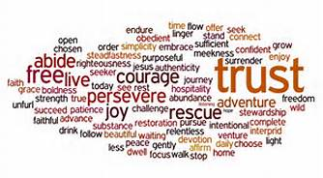
ONE WORD

Slide 2
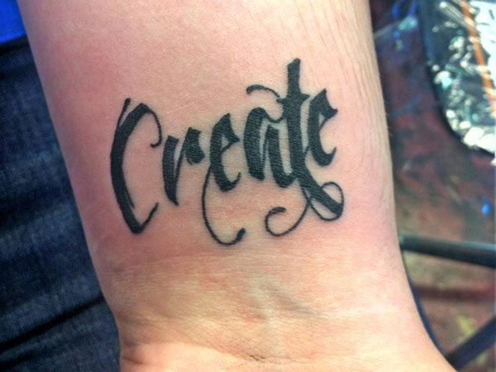

Slide 3
STEP 1 Determine the kind of person you want to become
The first step is to simply take some time and decide what kind of person you want to be at the end of this year.
This goes beyond simply being healthier and wealthier, but it must drive deep into your soul.

Slide 4
STEP 2 Identify the characteristics of that person
Get a picture of that person and then simply identify their major characteristics. Is that person gentle? Is that person generous?
What are the qualities of the person you want to become?

Slide 5
STEP 3 PICK A WORD
Once you have a list of the characteristics, simply pick a word.
There might be fifteen things that you want to change, but you must resist the temptation to promise you will do them all. Instead, simply commit to ONE WORD.

Slide 6
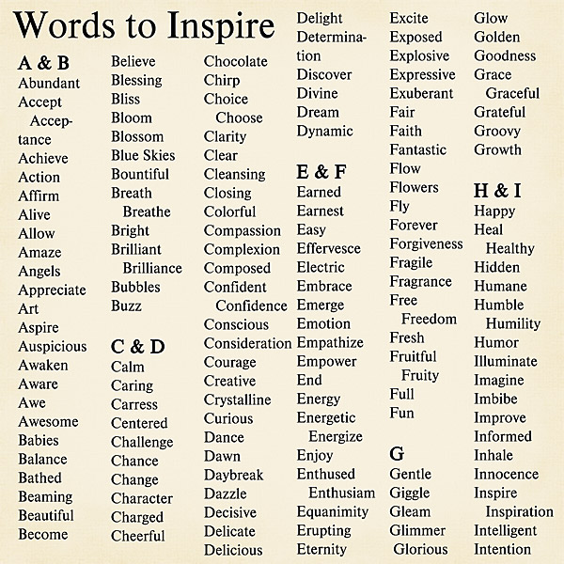

Slide 7
YOUR ASSIGNMENT
You will commit your word to a white piece of paper. Be creative. Use fun lettering. Add illustrations that symbolize your word. Be colorful. Remember, these words will be posted in our classroom.
Write, on a loose-leaf sheet of paper, a one page reflection on your word choice. Be specific. Explain how this word will connect to you this year.

